Slide 1
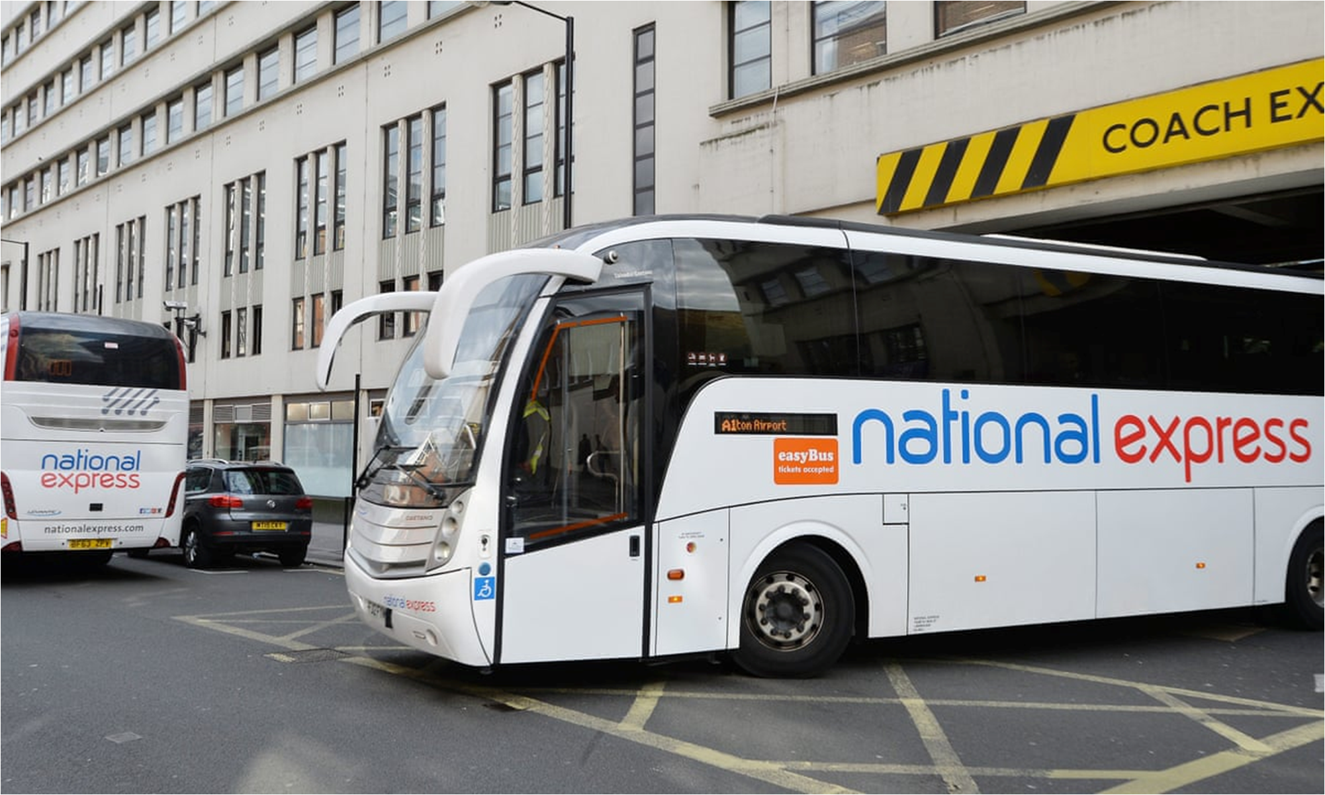
International Strategic Management (MAN7131)
Student’s Name:
Student’s ID:
Course:

Slide 2
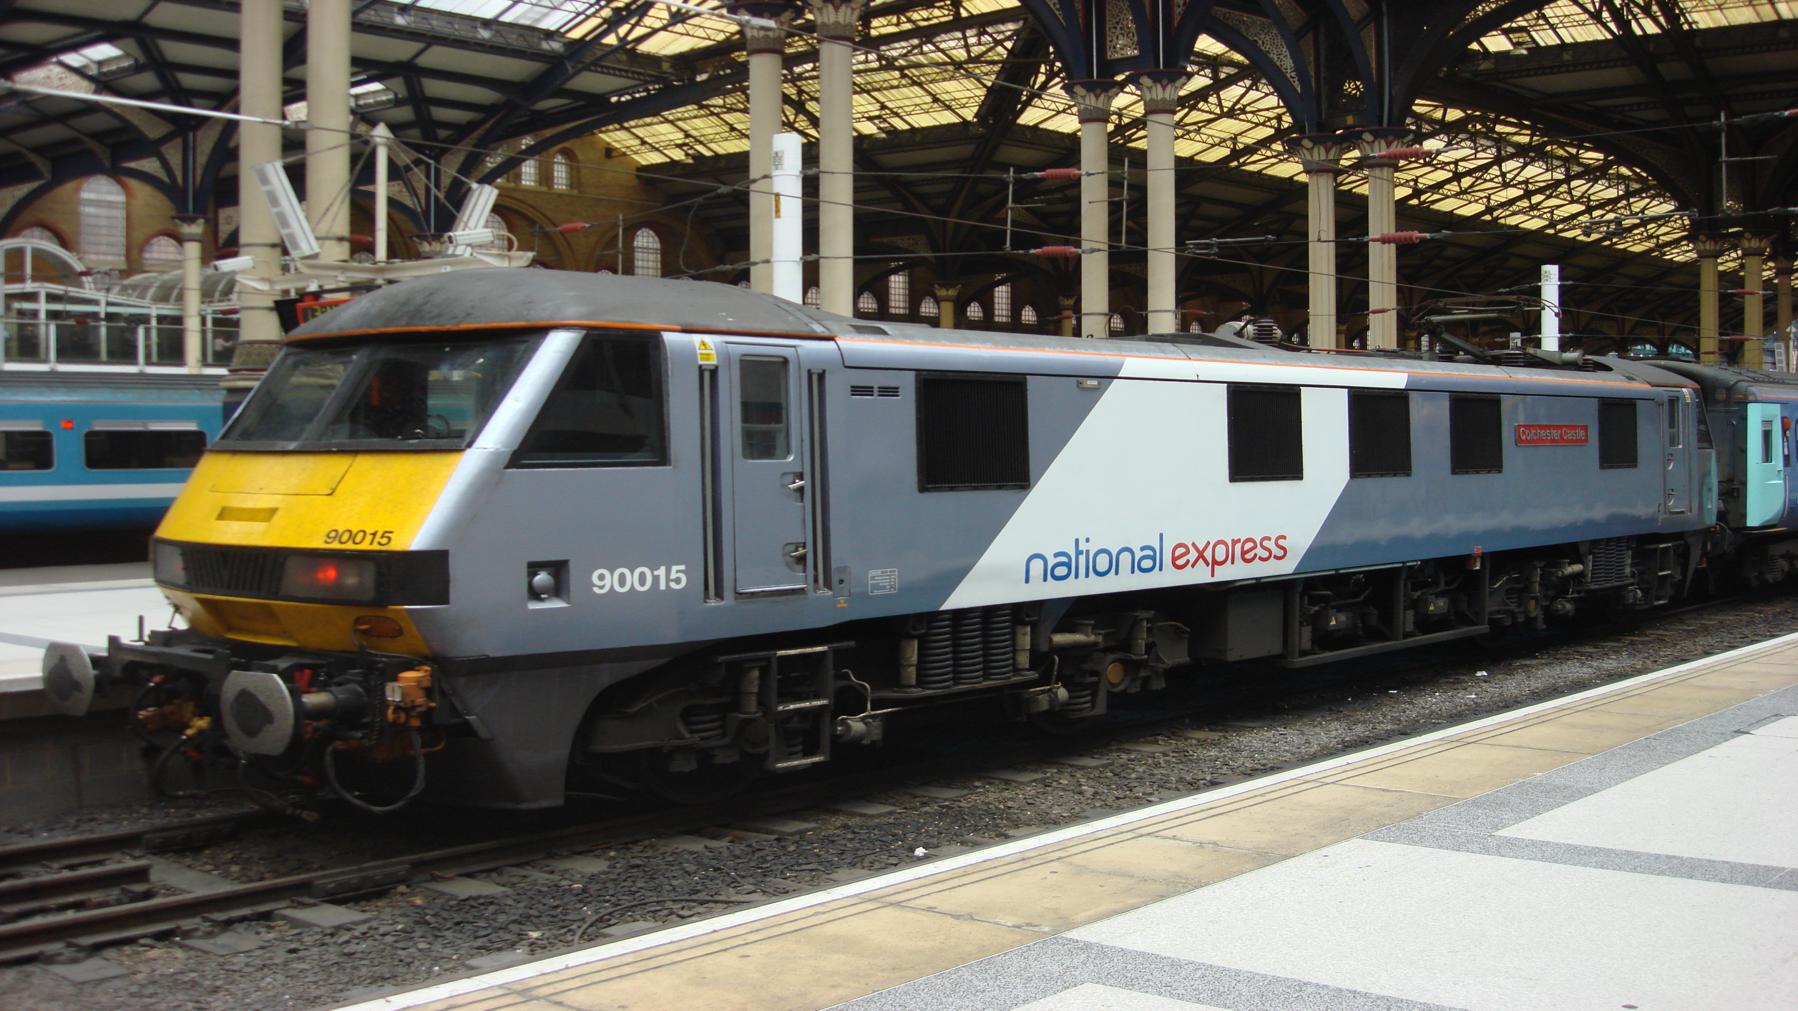
Table of Contents
Contents | Slides No
Introduction | 3
VMOST Analysis | 4
Stakeholder Analysis | 5
External Analysis | 6
Internal Analysis | 7
SWOT Analysis | 8
Strategy Options | 9
SFA Analysis | 10
Risk Assessment | 11
Conclusion | 12
References | 13
Thank You | 14

Slide 3
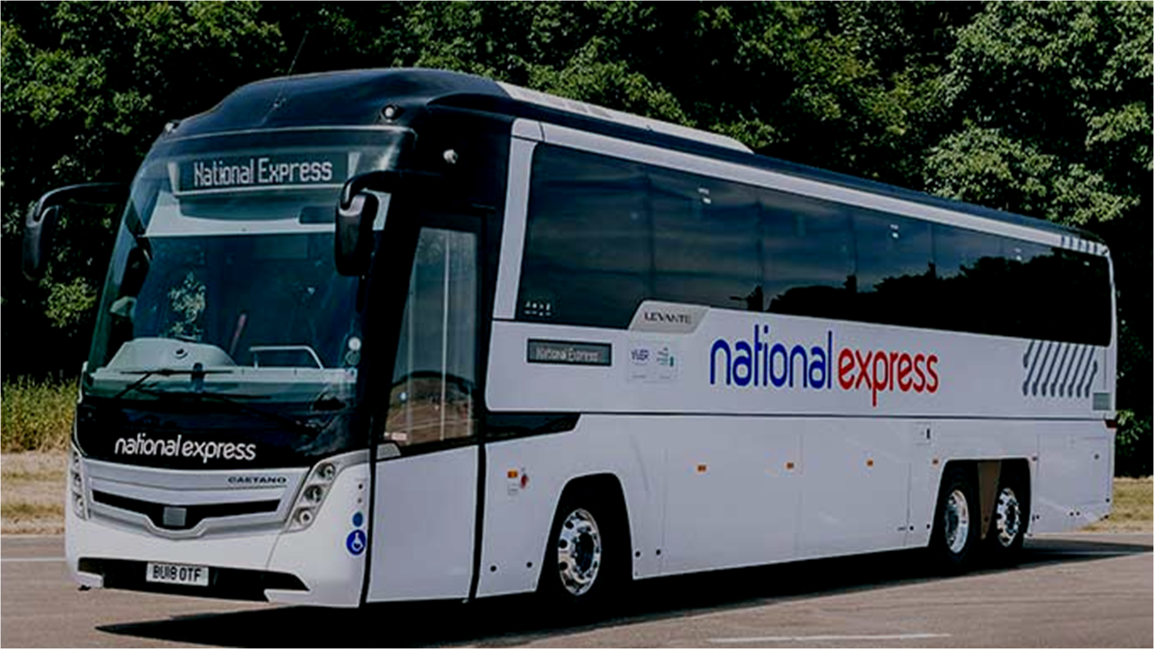
Introduction
National Express is a notable and distinguished transportation purveyor operating an extensive scope of bus, coach, and train amenities throughout the UK
Organisation was established in 1972 and holds a commendable record of furnishing reliable and cost-effective conveyance options to its clientele
Express, with an aggregate of over 46,200 labourers, stands as one of the most significant job providers in the UK
Notes:
1. Introduction
National Express is a notable and distinguished transportation purveyor operating an extensive scope of bus, coach, and train amenities throughout the UK. According to National Express Group PLC (2023a), the organisation was established in 1972 and holds a commendable record of furnishing reliable and cost-effective conveyance options to its clientele. National Express, with an aggregate of over 46,200 labourers, stands as one of the most significant job providers in the UK (National Express Group PLC, 2023b).

Slide 4
VMOST Analysis
Objectives:
To realise this vision, National Express has explicitly outlined objectives, including enriching customer contentment, reducing expenses, and broadening its coverage
Vision:
National Express aspires to be the preeminent public transportation purveyor in the United Kingdom by bestowing cost-effective, secure, and dependable services to its clientele
Mission:
Its objective is to connect individuals, communities, and enterprises through resourceful and sustainable transportation solutions
Strategies:
Its strategies encompass furnishing excellent amenities, investing in technology, and expanding its network
Tactics:
The measures include refining customer service, training personnel, and intensifying promotional campaigns
T
S
O
M
V
Notes:
2. VMOST
National Express aspires to be the preeminent public transportation purveyor in the United Kingdom by bestowing cost-effective, secure, and dependable services to its clientele. Its objective is to connect individuals, communities, and enterprises through resourceful and sustainable transportation solutions (National Express Group PLC, 2023c). To realise this vision, National Express has explicitly outlined objectives, including enriching customer contentment, reducing expenses, and broadening its coverage. Its strategies encompass furnishing excellent amenities, investing in technology, and expanding its network. The measures include refining customer service, training personnel, and intensifying promotional campaigns (National Express Group PLC, 2023c).

Slide 5
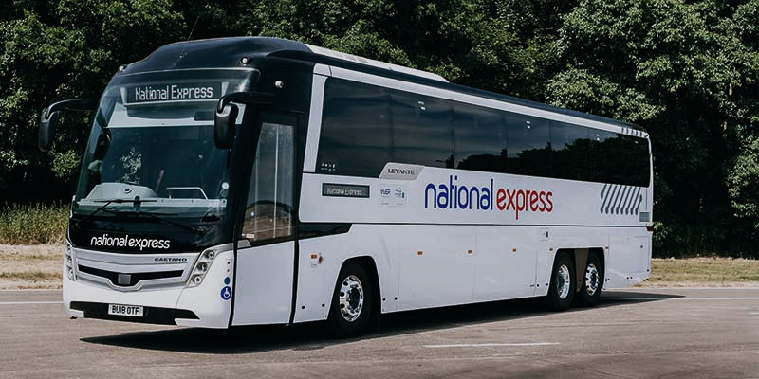
Stakeholder Analysis
Stakeholder analysis plays a pivotal role in comprehending the necessities, prospects, and apprehensions of a multitude of stakeholders capable of influencing an enterprise's triumph
National Express boasts of a vast assortment of stakeholders ranging from its clienteles, staff, stockholders, regulatory authorities, providers, to the societies it caters to
The company accedes that these stakeholders possess dissimilar and, at times, opposing interests, thereby devising stratagems to regulate and equilibrate them
To sustain affirmative relationships with its stakeholders, National Express accords top priority to customer contentment, employee involvement, and environmental sustainability
Notes:
3. Stakeholder Analysis
Stakeholder analysis plays a pivotal role in comprehending the necessities, prospects, and apprehensions of a multitude of stakeholders capable of influencing an enterprise's triumph (Alhawari et al., 2021). National Express boasts of a vast assortment of stakeholders ranging from its clienteles, staff, stockholders, regulatory authorities, providers, to the societies it caters to. The company accedes that these stakeholders possess dissimilar and, at times, opposing interests, thereby devising stratagems to regulate and equilibrate them. To sustain affirmative relationships with its stakeholders, National Express accords top priority to customer contentment, employee involvement, and environmental sustainability.

Slide 6
External Analysis
Competitor Analysis
Pestel Analysis
Porter’s Five Forces
The main competitors of National Express are Arriva, Stagecoach and FirstGroup
These companies offer similar services, including coach, bus, and train travel throughout the UK
To maintain its competitiveness, National Express has implemented tactics such as investing in advanced technology and expanding its range of routes and services
Political | It is critical for National Express to maintain amicable relations with government regulators while ensuring compliance with relevant laws and regulations
Economic | National Express can be impacted in times of economic downturn, government funding for transport infrastructure tends to be reduced
Social | The transport requirements of an ageing population would differ significantly from those of a younger demographic
Technological | Technological advancements, such as the emergence of new transport technologies and the use of data analytics to enhance efficiency and customer experience, can significantly impact National Express
Legal | National Express must conform to a slew of legal requirements, including health and safety regulations, employment laws, and competition laws
Environmental | National Express recognises the importance of environmental sustainability and has taken several measures to minimise its environmental footprint, such as investing in low-emission vehicles and utilising renewable energy sources
Threat of New Entry | High
Bargaining Power of Suppliers | Low
Bargaining Power of Customers | High
Threat of Substitutes | High
Competitive Rivalry | Stagecoach, Arriva and FirstGroup
Notes:
4. External Analysis
4.1 Competitor Analysis
As indicated by FirstGroup plc (2022), Arriva (2023) and Stagecoach UK Bus (2023), National Express faces quite a competition from Stagecoach, FirstGroup and Arriva. These companies offer similar services, including coach, bus, and train travel throughout the UK. To maintain its competitiveness, National Express has implemented tactics such as investing in advanced technology and expanding its range of routes and services.
4.2 Porter’s Five Forces
National Express faces intense competitive pressures in the public transportation industry, including threats from new entrants and price rivalry from competitors like FirstGroup, Arriva, and Stagecoach UK Bus (FirstGroup plc, 2022; Arriva, 2023; Stagecoach UK Bus, 2023). Suppliers hold relatively low bargaining power due to National Express's vast and diverse supply chain, but buyers have high bargaining power due to the many options available for transportation services. In addition, it is indicated by Irawan et al. (2020) that the possibility of substitutes, such as taxis and private cars, is significant.
4.3 PESTLE Analysis
It is critical for National Express to maintain amicable relations with government regulators while ensuring compliance with relevant laws and regulations (Floridi, 2019).
National Express can be impacted in times of economic downturn, government funding for transport infrastructure tends to be reduced (Mattioli et al., 2020).
As indicated by Cheng et al. (2019), the transport requirements of an ageing population would differ significantly from those of a younger demographic.
Technological advancements, such as the emergence of new transport technologies and the use of data analytics to enhance efficiency and customer experience, can significantly impact National Express' operations (Wang et al., 2021).
National Express must conform to a slew of legal requirements, including health and safety regulations, employment laws, and competition laws (Singh, 2022).
National Express recognises the importance of environmental sustainability and has taken several measures to minimise its environmental footprint, such as investing in low-emission vehicles and utilising renewable energy sources (Ramzan et al., 2023).Top of Form

Slide 7
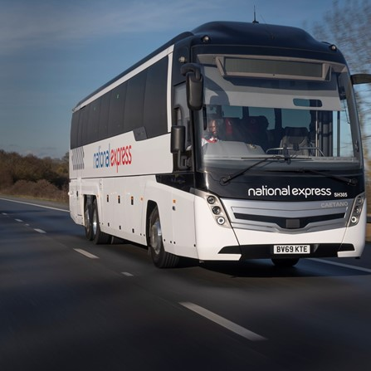
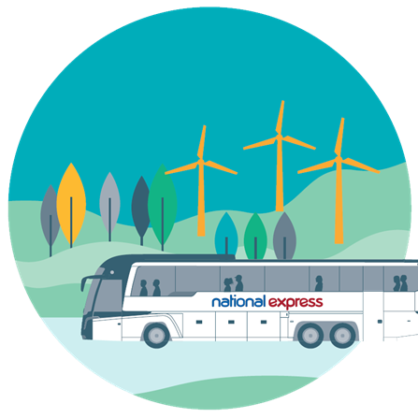
Internal Analysis
VRIO Analysis
FIMO
National Express has valuable, uncommon, and difficult-to-imitate resources and capabilities, including an extensive transportation network, investment in sustainable vehicles, and a skilled workforce
However, some of these resources may require restructuring to maximise value creation
By identifying and capitalising on key resources and capabilities, National Express can maintain a competitive edge in the public transportation industry
Fi (Financials) | National Express has a robust finance capability with steady revenue growth and profit margins
M (Marketing) | National Express' marketing strategies are centred on providing high-quality customer service and promoting environmental responsibility
O (Operations) | The company boasts of a wide range of transportation services and a skilled workforce, which contribute to its operational capabilities
Notes:
5. Internal Analysis
5.1 FiMO
National Express has a robust finance capability with steady revenue growth and profit margins (National Express Group PLC, 2023b). National Express' marketing strategies are centred on providing high-quality customer service and promoting environmental responsibility (National Express Group PLC, 2023c). Additionally, the company boasts of a wide range of transportation services and a skilled workforce, which contribute to its operational capabilities. (National Express Group PLC, 2023b).
5.2 VRIO Analysis
National Express has valuable, uncommon, and difficult-to-imitate resources and capabilities, including an extensive transportation network, investment in sustainable vehicles, and a skilled workforce (National Express Group PLC, 2023b; National Express Group PLC, 2023d). However, some of these resources may require restructuring to maximise value creation. By identifying and capitalising on key resources and capabilities, National Express can maintain a competitive edge in the public transportation industry.

Slide 8
SWOT Analysis
s
W
O
T
Strengths
Weakness
Opportunities
Threats
strong financial position
diverse network of transport services
limited global presence
reliance on government agreements for revenue
acquiring smaller competitors
entering new markets
growing competition within the industry
potential economic downturns
changing regulatory measures and policies
Notes:
6. SWOT Analysis
National Express has several strengths, including a strong financial position and a diverse network of transport services (Alkharabsheh et al., 2021). However, the company also has weaknesses, such as limited global presence and reliance on government agreements for revenue (Mattioli et al., 2020). There are opportunities for National Express to grow, including acquiring smaller competitors and entering new markets (Akpan, Udoh and Adebisi, 2022). Nevertheless, the company faces threats, such as growing competition within the industry, potential economic downturns, and changing regulatory measures and policies (Brand-Correa et al., 2020).

Slide 9
Strategy Options
Market Development:
Expand into new markets or demographic segments with existing products or services
Diversification:
Pursue new markets or industries beyond public transport, such as ride-sharing or car-sharing services
Market Penetration:
Increase market share in existing markets by improving prices, marketing efforts and services
Product Development:
Implement new products or services in existing markets through new technologies or infrastructure
Notes:
7. Strategy Options
Increase market share in existing markets by improving prices, marketing efforts and services (Nalmpantis et al., 2019).
Expand into new markets or demographic segments with existing products or services (Patrick and Hollenbeck, 2021).
Implement new products or services in existing markets through new technologies or infrastructure (Hepburn et al., 2021).
Pursue new markets or industries beyond public transport, such as ride-sharing or car-sharing services (Wilson and Mason, 2020).

Slide 10
SFA Analysis
National Express can leverage its expertise in managing large transport networks to expand into emerging markets
Finally, investing in more sustainable solutions could provide a competitive advantage in a market where environmental awareness is increasing
The company already has a presence in the tourism sector through its coach services
Notes:
8. SFA Analysis
National Express can leverage its expertise in managing large transport networks to expand into emerging markets (Gambo and Musonda, 2021). The company already has a presence in the tourism sector through its coach services (National Express Group PLC, 2023b). Finally, investing in more sustainable solutions could provide a competitive advantage in a market where environmental awareness is increasing (National Express Group PLC, 2023b).

Slide 11
Risk Assessment
Disruptive technologies
Regulatory changes
Increased competition from new entrants
Notes:
9. Risk Assessment
To ensure success, National Express should assess potential threats and uncertainties. Risks include increased competition from new entrants and disruptive technologies like ride-hailing and autonomous vehicles, as well as regulatory changes that could impact the company's operations and profitability (Pangbourne et al., 2020; Eisenmann et al., 2021).

Slide 12










Conclusion
National Express faces considerable competition from Stagecoach, FirstGroup and Arriva and it needs to maintain amicable relations with the government regulators. However, the company has considerable strength in finance capability and marketing strategies and can sought much opportunities in expanding to new areas as well as by overtaking small competitions.
Notes:
10. Conclusion
National Express faces considerable competition from Stagecoach, FirstGroup and Arriva and it needs to maintain amicable relations with the government regulators. However, the company has considerable strength in finance capability and marketing strategies and can sought much opportunities in expanding to new areas as well as by overtaking small competitions.

Slide 13
References
Akpan, I.J., Udoh, E.A.P. and Adebisi, B., 2022. Small business awareness and adoption of state-of-the-art technologies in emerging and developing markets, and lessons from the COVID-19 pandemic. Journal of Small Business & Entrepreneurship, 34(2), pp.123-140.
Alhawari, O., Awan, U., Bhutta, M.K.S. and Ülkü, M.A., 2021. Insights from circular economy literature: A review of extant definitions and unravelling paths to future research. Sustainability, 13(2), p.859.
Alkharabsheh, A., Moslem, S., Oubahman, L. and Duleba, S., 2021. An integrated approach of multi-criteria decision-making and grey theory for evaluating urban public transportation systems. Sustainability, 13(5), p.2740.
Arriva, 2023. Transport leader. [online] Available at: https://www.arriva.co.uk/en/transport-leader/about-us/our-vision-and-values [Accessed on: 24 April 2023]
Baxter, G., 2019. A strategic analysis of Cargolux Airlines International position in the global air cargo supply chain using Porter’s Five Forces Model. Infrastructures, 4(1), p.6.
Brand-Correa, L.I., Mattioli, G., Lamb, W.F. and Steinberger, J.K., 2020. Understanding (and tackling) need satisfier escalation. Sustainability: Science, Practice and Policy, 16(1), pp.309-325.
Cheng, L., Chen, X., Yang, S., Cao, Z., De Vos, J. and Witlox, F., 2019. Active travel for active ageing in China: The role of built environment. Journal of transport geography, 76, pp.142-152.
Eisenmann, C., Nobis, C., Kolarova, V., Lenz, B. and Winkler, C., 2021. Transport mode use during the COVID-19 lockdown period in Germany: The car became more important, public transport lost ground. Transport policy, 103, pp.60-67.
FirstGroup plc, 2022. FirstGroup is a leading private sector provider of public transport. We provide easy and convenient mobility, improving quality of life by connecting people and communities. [online] Available at: https://www.firstgroupplc.com/ [Accessed on: 24 April 2023]
Floridi, L., 2019. Establishing the rules for building trustworthy AI. Nature Machine Intelligence, 1(6), pp.261-262.
Gambo, N. and Musonda, I., 2021. Effect of the fourth Industrial Revolution on road transport asset management practice in Nigeria. Journal of Construction in Developing Countries, 26(1), pp.19-43.
Hepburn, C., Qi, Y., Stern, N., Ward, B., Xie, C. and Zenghelis, D., 2021. Towards carbon neutrality and China's 14th Five-Year Plan: Clean energy transition, sustainable urban development, and investment priorities. Environmental Science and Ecotechnology, 8, p.100130.
Irawan, M.Z., Belgiawan, P.F., Tarigan, A.K.M. and Wijanarko, F., 2020. To compete or not compete: exploring the relationships between motorcycle-based ride-sourcing, motorcycle taxis, and public transport in the Jakarta metropolitan area. Transportation, 47, pp.2367-2389.
Mattioli, G., Roberts, C., Steinberger, J.K. and Brown, A., 2020. The political economy of car dependence: A systems of provision approach. Energy Research & Social Science, 66, p.101486.
Mattioli, G., Roberts, C., Steinberger, J.K. and Brown, A., 2020. The political economy of car dependence: A systems of provision approach. Energy Research & Social Science, 66, p.101486.
Nalmpantis, D., Roukouni, A., Genitsaris, E., Stamelou, A. and Naniopoulos, A., 2019. Evaluation of innovative ideas for Public Transport proposed by citizens using Multi-Criteria Decision Analysis (MCDA). European Transport Research Review, 11(1), pp.1-16.
National Express Group PLC, 2023a. Our history. [online] Available at: https://www.nationalexpressgroup.com/about-us/our-history/ [Accessed on: 24 April 2023]
National Express Group PLC, 2023b. About us. [online] Available at: https://www.nationalexpressgroup.com/about-us/ [Accessed on: 24 April 2023]
National Express Group PLC, 2023c. Our vision, purpose and values. [online] Available at: https://www.nationalexpressgroup.com/about-us/our-vision-purpose-and-values/ [Accessed on: 24 April 2023]
National Express Group PLC, 2023d. Sustainability is at the heart of National Express Group. [online] Available at: https://www.nationalexpressgroup.com/sustainability/ [Accessed on: 24 April 2023]
Pangbourne, K., Mladenović, M.N., Stead, D. and Milakis, D., 2020. Questioning mobility as a service: Unanticipated implications for society and governance. Transportation research part A: policy and practice, 131, pp.35-49.
Patrick, V.M. and Hollenbeck, C.R., 2021. Designing for all: Consumer response to inclusive design. Journal of consumer psychology, 31(2), pp.360-381.
Ramzan, M., Razi, U., Quddoos, M.U. and Adebayo, T.S., 2023. Do green innovation and financial globalization contribute to the ecological sustainability and energy transition in the United Kingdom? Policy insights from a bootstrap rolling window approach. Sustainable Development, 31(1), pp.393-414.
Singh, A., 2022. Interplay of the Growing Digital Media and Entertainment Industry with Competition Laws. Supremo Amicus, 30, p.502.
Stagecoach UK Bus, 2023. About Stagecoach. [online] Available at: https://www.stagecoachbus.com/about/national# [Accessed on: 24 April 2023]
Wang, L., Chen, Y., Ramsey, T.S. and Hewings, G.J., 2021. Will researching digital technology really empower green development?. Technology in Society, 66, p.101638.
Wilson, A. and Mason, B., 2020. The coming disruption–The rise of mobility as a service and the implications for government. Research in transportation economics, 83, p.100898.

Slide 14
Thank You!
Any Questions?

